Slide 1
Data Preprocessing
Course: CS 430-01
Instructor: Sayani Sarkar, Ph.D.

Slide 2
Machine Learning project checklist
Frame the problem and look at the big picture.
Get the data.
Explore the data to gain insights.
Prepare the data to better expose the underlying data patterns to ML algorithms.
Explore many different models and shortlist the best ones.
Fine-tune your models and combine them into a great solution.
Present your solution.
Launch, monitor, and maintain your system.
*You'll often see slight variations of this checklist. Modify to suit your own situation and needs!

Slide 3
Introduction to our provided data set
California Housing Prices dataset (StatLib repository)
https://www.kaggle.com/datasets/camnugent/california-housing-prices
Based on data from the 1990 California census (hence currently unrealistic).
Author removed some features and added a categorical feature (more instructive).

Slide 4
Frame the Problem
Knowing the objective is important because it will determine
how you frame the problem
which algorithms you will select
which performance measure you will use to evaluate your model
how much effort you will spend tweaking

Slide 5
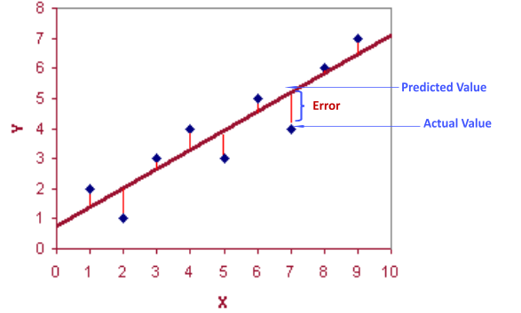
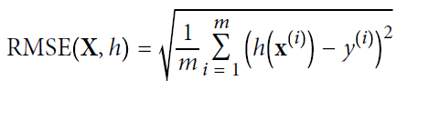
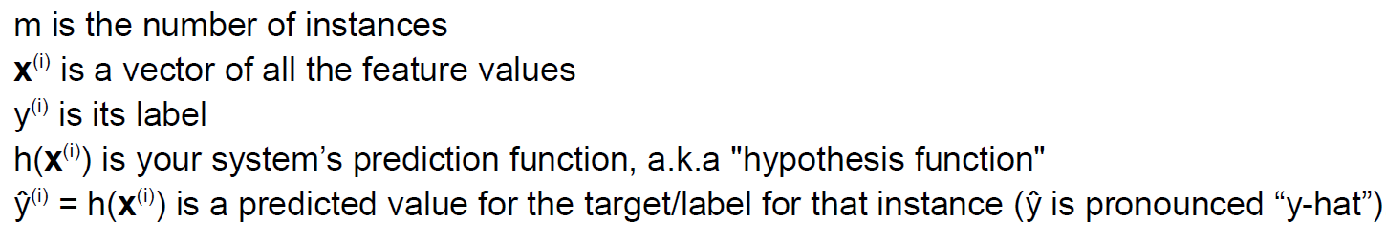
Performance Measure
A typical performance measure for regression problems is the Root Mean Square Error (RMSE).
It gives an idea of how much error the system typically makes in its predictions, higher weight for large errors.

Slide 6

Some Facts on RMSE
Why we square up the residuals?
To penalize large errors.
Easy to differentiate (important for derivative-based methods such as gradient descent).
Why Square root?
Brings us back to the natural, interpretable units of the problem.
Mean absolute error (MAE):
MAE is preferable when you know you've got plenty of outliers and you know that residuals are not going to end up having a Normal/Guassian distribution.

Slide 7
Downloading Anaconda
Visit https://www.anaconda.com/products/individual
Select suitable operating system (Windows/MacOS/Linux) where the three operating systems are listed
Download ...
Open and run the installer ...
Open the Anaconda Prompt from the start menu:
Windows: Click Start, search Anaconda Prompt from the menu.
MacOS: Cmd+Space to open Spotlight Search and
type “Navigator” to open the program.
Linux: Open Applications - System Tools - terminal.
Terminal – type python --version

Slide 8
Packages
jupyter – Notebook to start working with
Matplotlib, Seaborn - Plotting library
https://matplotlib.org/
https://seaborn.pydata.org/
numpy - Numerical computing tools
pandas- Data manipulation and analysis
scikit-learn- free software machine learning library
https://scikit-learn.org/stable/
Keras Tensorflow for Deep Learning

Slide 9
California Housing Price
1. longitude: A measure of how far west a house is; a higher value is farther west 2. latitude: A measure of how far north a house is; a higher value is farther north 3. housingMedianAge: Median age of a house within a block; a lower number is a newer building 4. totalRooms: Total number of rooms within a block 5. totalBedrooms: Total number of bedrooms within a block 6. population: Total number of people residing within a block 7. households: Total number of households, a group of people residing within a home unit, for a block 8. medianIncome: Median income for households within a block of houses (measured in tens of thousands of US Dollars) 9. medianHouseValue: Median house value for households within a block (measured in US Dollars) 10. oceanProximity: Location of the house w.r.t ocean/sea

Slide 10
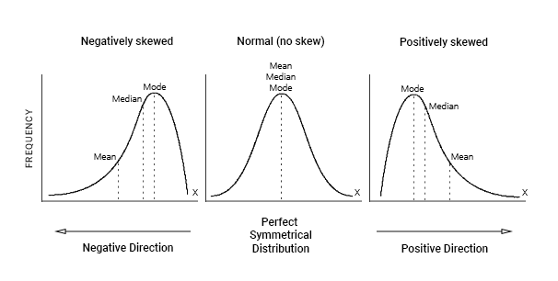
Positive and Negative Skew of the Dataset
Where is the mean in relation to the median?

Slide 11
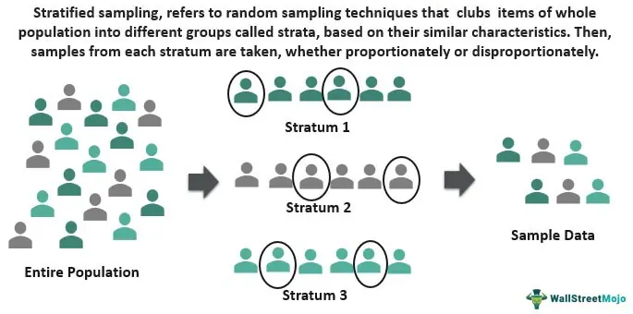
Stratified Sampling
train_test_split is generally fine if your dataset is large enough, if not there is a chance of Sampling Bias.
Source: Stratified Sampling (wallstreetmojo.com)

Slide 12

Data Cleaning

Slide 13
Scikit-Learn Design
Estimators - Any object that can estimate some parameters based on a dataset
will always have a fit() method
Transformers - Estimators (such as an imputer) that can also transform a dataset.
will always have transform(), fit_transform() methods
Predictors - Estimators that are capable of making predictions on dataset.
will always have predict(), score() methods

Slide 14
Data Cleaning
Most Machine Learning algorithms cannot work with missing features.
Problem: 'total_bedrooms' attribute has some missing values. There are a few options...
Get rid of the corresponding districts (drop rows).
Get rid of the whole attribute (drop column).
Set the values to some value (fill or impute).

Slide 15
Missing data
Missing values are common in dealing with real-world problems when the data is aggregated over long time stretches from disparate sources, and reliable machine learning modeling demands for careful handling of missing data
Missing values replaced with mean, median and mode but you will need to decide which one
Mean: mean imputation not good idea and imputing missing data with mean values can only be done with numerical data
Median: When the data is skewed, it is good to consider using the median value for replacing the missing values and it can only be done with numerical data
Mode value or most frequent value: When the data is skewed, it is good to consider using mode values for replacing the missing values. Imputing missing data with mode values can be done with numerical and categorical data.
Salary data is skewed

Slide 16
Imputing missing value
from sklearn.impute import SimpleImputer
imputer = SimpleImputer(strategy='mean’)
imputer = SimpleImputer(strategy='median’)
imputer = SimpleImputer(strategy='most_frequent’)
imputer = SimpleImputer(strategy='constant', fill_value=80)
imputer = SimpleImputer(strategy='constant', fill_value='F’)

Slide 17
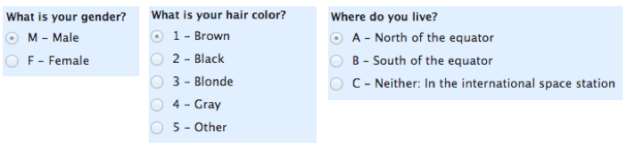
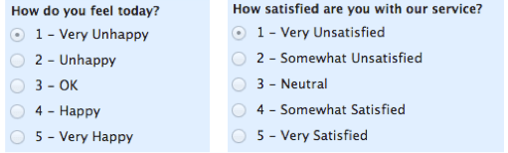
Encoding categorical data
Categorical data can be considered as gathered information that is divided into two groups.
Nominal data : consists of the name variable without any numerical values
Ordinal data : consists of a set of orders or scales
Most of the machine learning models work with integer values only and some with other different values which can be understandable for the model.
Encoding categorical data is a process of converting categorical data into integer format so that the data with converted categorical values can be provided to the models to give and improve the predictions

Slide 18
Ordinal Encoding
This type of encoding is used when the variables in the data are ordinal, ordinal encoding converts each label into integer values and the encoded data represents the sequence of labels.
# Encoding the Dependent Variable
from sklearn.preprocessing import OrdinalEncoder
OE= OrdinalEncoder()
housing['ocean_proximity']=OE.fit_transform(housing[['ocean_proximity']])

Slide 19
One-Hot Encoding
In One-Hot Encoding, each category of any categorical variable gets a new variable.
It maps each category with binary numbers (0 or 1).
This type of encoding is used when the data is nominal.
Newly created binary features can be considered dummy variables.
After one hot encoding, the number of dummy variables depends on the number of categories presented in the data.
df1 = pd.get_dummies(df1[['Name', 'Age', 'Weight', 'Size’]])
print(df1)

Slide 20
Dummy Variable Trap -Multicollinearity
The Dummy Variable Trap occurs when two or more dummy variables created by one-hot encoding are highly correlated (multi-collinear).
This means that one variable can be predicted from the others, making it difficult to interpret predicted coefficient variables in regression models.
In other words, the individual effect of the dummy variables on the prediction model can not be interpreted well because of multicollinearity.
To avoid the dummy variable trap, the last dummy variable is dropped by setting drop_first=True
df = pd.get_dummies(df[['Name', 'Age', 'Weight', 'Size']], drop_first=True)

Slide 21
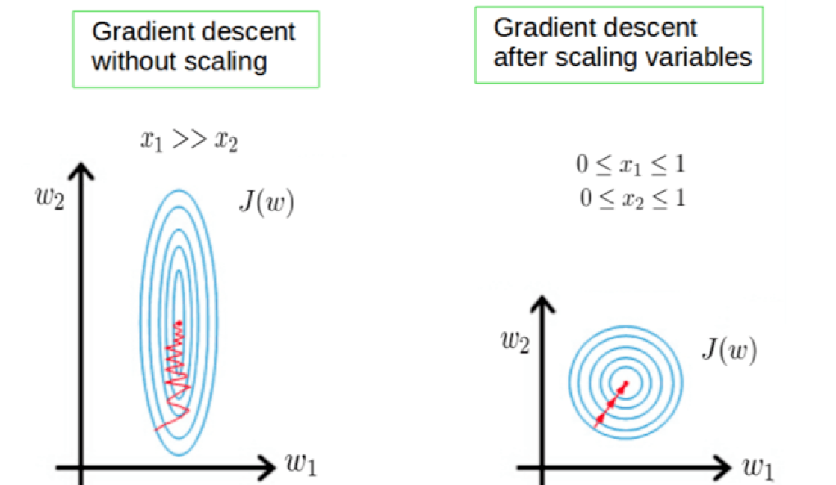
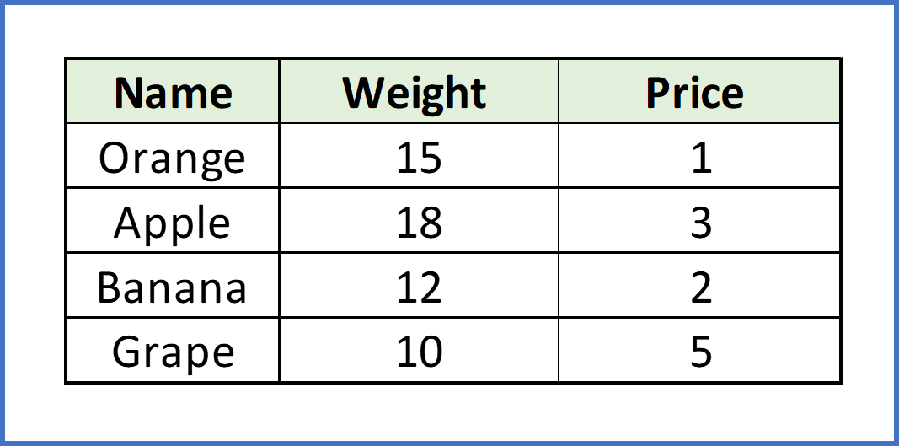
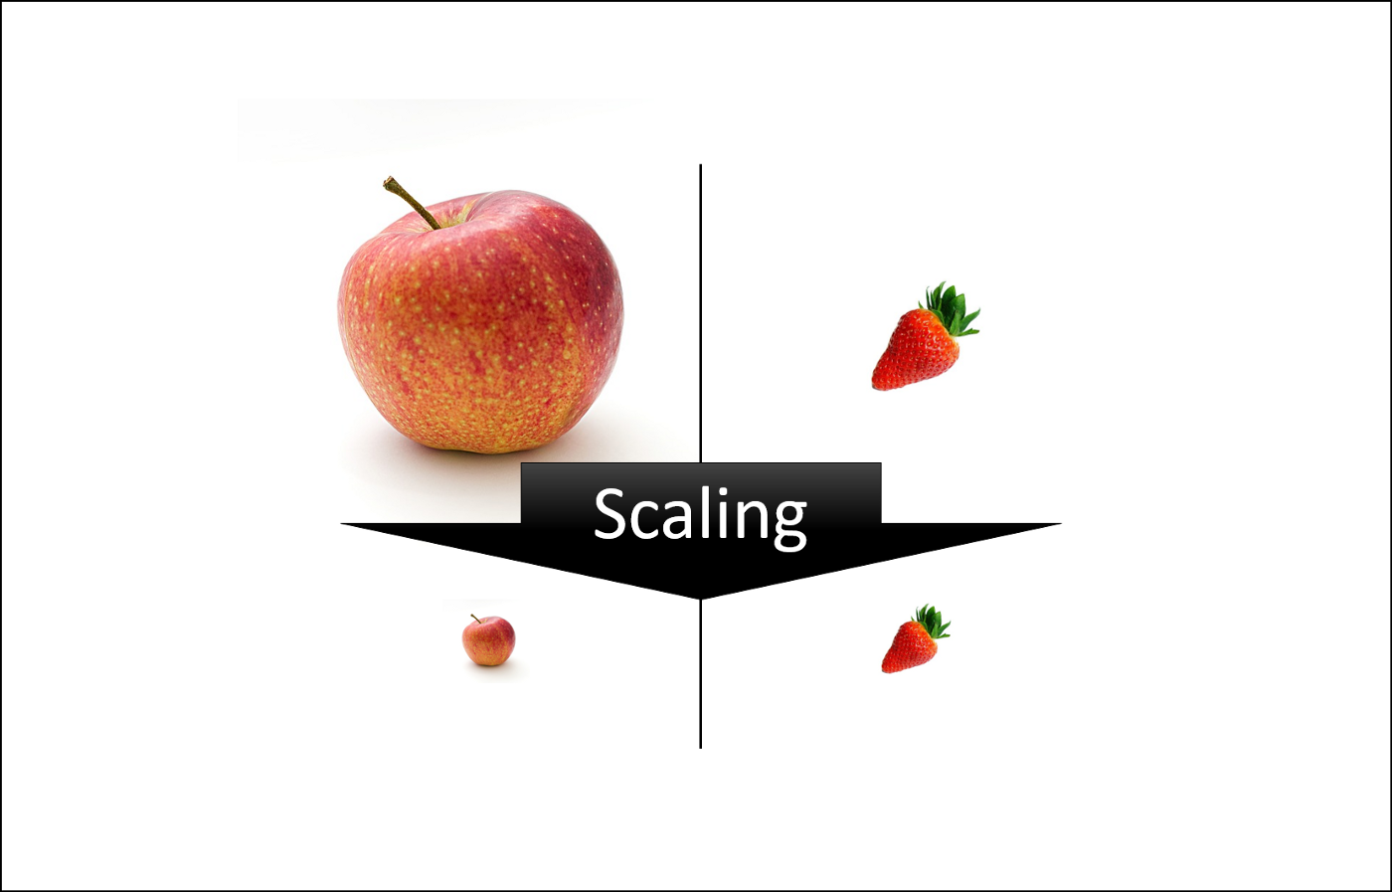
Feature Scaling
Feature scaling is mapping the feature values of a dataset into the same range.
Machine learning algorithm just sees number — if there is a vast difference in the range say few ranging in thousands and few ranging in the tens, and it makes the underlying assumption that higher ranging numbers have superiority of some sort.
"With few exceptions, Machine Learning algorithms don’t perform well when the input numerical attributes have very different scales."
The most common techniques of feature scaling are Normalization and Standardization.

Slide 22


Feature Scaling Impact
Distance base algorithms like KNN, K-means, and SVM are most affected by the range of features. This is because behind the scenes they are using distances between data points to determine their similarity.
Tree-based algorithms, on the other hand, are insensitive to the scale of the features.
Normalization is a scaling technique in which values are shifted and rescaled so that they end up ranging between 0 and 1. It is also known as Min-Max scaling. This scales the range to [0, 1] or sometimes [-1, 1]
Standardization is another scaling technique where the values are centered around the mean with a unit standard deviation. μ is mean, σ is standard deviation

Slide 23
Feature Scaling cont.
Normalization is good to use when you know that the distribution of your data does not follow a Gaussian distribution. This can be useful in algorithms that do not assume any distribution of the data like K-Nearest Neighbors and Neural Networks.
Standardization, on the other hand, can be helpful in cases where the data follows a Gaussian distribution. However, this does not have to be necessarily true. Also, unlike normalization, standardization does not have a bounding range. So, even if you have outliers in your data, they will not be affected by standardization.
from sklearn.preprocessing import MinMaxScaler, StandardScaler
sc_X = StandardScaler()
MM_X=MinMaxScaler()
X = sc_X.fit_transform(X)
X1 = MM_X.fit_transform(X)

Slide 24

Feature Scaling Cont.
Feature scaling is crucial for some machine learning algorithms, which consider distances between observations because the distance between two observations differs for non-scaled and scaled cases.
Some examples of algorithms where feature scaling matters are:
SVM, K-nearest neighbors (KNN), Principal Component Analysis(PCA)
The most common way to perform feature scaling: Min-Max scaler
Transform features by scaling each feature to a given range. This estimator scales and translates each feature individually such that it is in the given range on the training set
from sklearn.preprocessing import StandardScaler
sc_X = StandardScaler()
X = sc_X.fit_transform(X)
print(X)

